Slide 1


Exploring the Impact of Interest Rate Changes on the Australian Housing Market: Insights from Interactive Data Visualizations
Group 4 – Anshuman Panigrahi, Robert Franklin, Zalak Shah
January 2023
Notes:
ROB
Hi everyone, for our project Anshu, Zalak and I created an interactive data dashboard to explore the impact of interest rate changes on the Australian Housing market.

Slide 2
Table of contents
01 | Introduction | 3
02 | Our Approach | 5
03 | Our Interactive Dashboard | 7
04 | Limitations & Future Work | 12
05 | Q&A! | 14
Notes:
ROB
First, I will introduce project in more detail,
then we will look at our data analysis approach,
Then we’ll go through our interactive dashboard
And lastly at look at some of the limitations of our analysis with a view to future work,

Slide 3
Introduction
01
Notes:
ROB

Slide 4
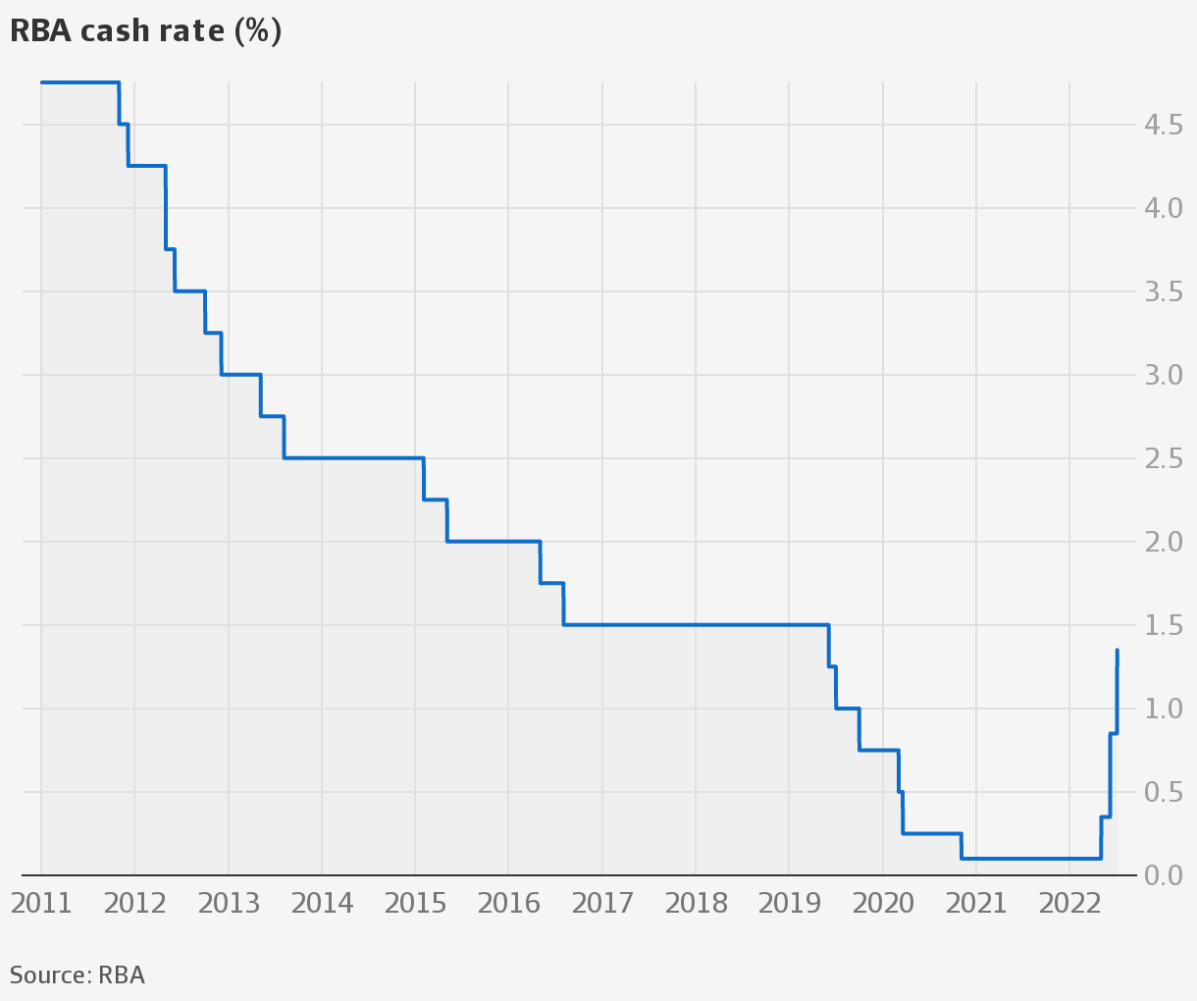
Introduction: InteractiveDataViz
Brief overview of the project (key terms: Cash Rate, RBA)
Purpose of the project
Importance of understanding the relationship between interest rate changes and the Australian housing market
Notes:
ROB
Inspiration for this project came from the need to understand the likely impacts of recent accelerated interest rate changes on the Australian housing market.
Just to give you a brief explanation of the terms we will use.
The Cash Rate, which is set by the Reserve Bank of Australia (RBA), affects the cost of borrowing money. When the Cash Rate is high, it's more expensive to borrow and may slow down the housing market. If it's low, borrowing is cheaper and the housing market may become more active. Over the last 10 years, the Cash Rate has decreased, but recently started to increase to address rising inflation.
The RBA's decisions on the cash rate can have a significant impact on the Australian housing market, and it’s really important for people to be aware of these changes.
This project is a unique contribution to understand these changes.

Slide 5
Our Approach
02
Notes:
ROB
- Now for a look at our data analysis approach.

Slide 6
Approach
01
Identify data sources
02
ETL
03
Web Framework
04
Data Visualisation
03
ABS & RBA
Recent data only
Extraction: API & Web scraping
Transform: Python (Jupyter Notebooks), Pandas DataFrame
Load: SQL, SQLAlchemy, Postgres, Amazon
HTML: Bootstrap navbar, grid system, & container-fluid,
CSS,
Python Flask app.
Javascript (Plotly, Jquery, D3, Leaflet)
Notes:
ROB 01- Data Sources
Only accessed official economic & govt data souces, specially the ABS and RBA
Looked at recent data only from about the last 10 years
I’ll now hand over to Anshu to talk through the ETL and Web Framework
ANSHU 02 & 03 – ETL & Web Framework
uses SQLAlchemy as the Object Relational Mapper (ORM) to interact with a remote database hosted on Amazon Web Services (AWS). The database username and password are stored in a gitignore file (console.py) to protect sensitive information.
Flask app serves as the dynamic content to the user's browser.
Use of ajax technique AJAX to send requests to the server in the background, without reloading the entire page, and updating parts of the page based on the response.
ROB 04 – Data Visualisation
Plotly for charts.
Leaflet for our maps, using D3 to get GeoJSON data for Australian states.

Slide 7
Our Interactive Dashboard
03
Notes:
ROB
Now for a look at the output - our interactive dashboard

Slide 8
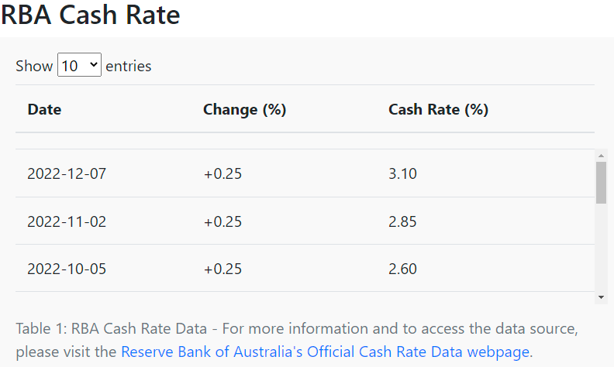
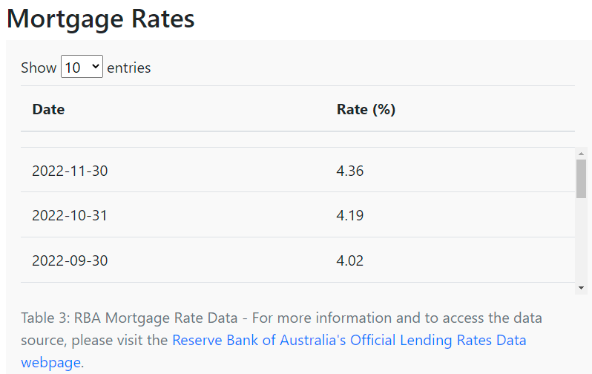
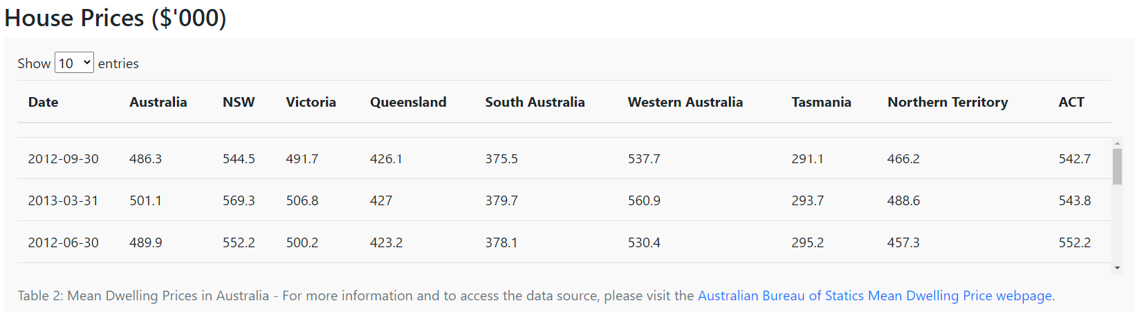
Data Tables
Cash Rate, Mortgage Rate & House Price Data Tables Jquery
Table captions point clearly to data sources
Notes:
ROB
First, we have some interactive data tables which were created using the DataTables plug-in for the jQuery JavaScript library.
Provides easy to use and interactive tables, this is real-time data
Dynamic filtering and sorting of data
User-friendly interface with intuitive navigation, caption with the link to the data source.
quick summary of each columns data.

Slide 9
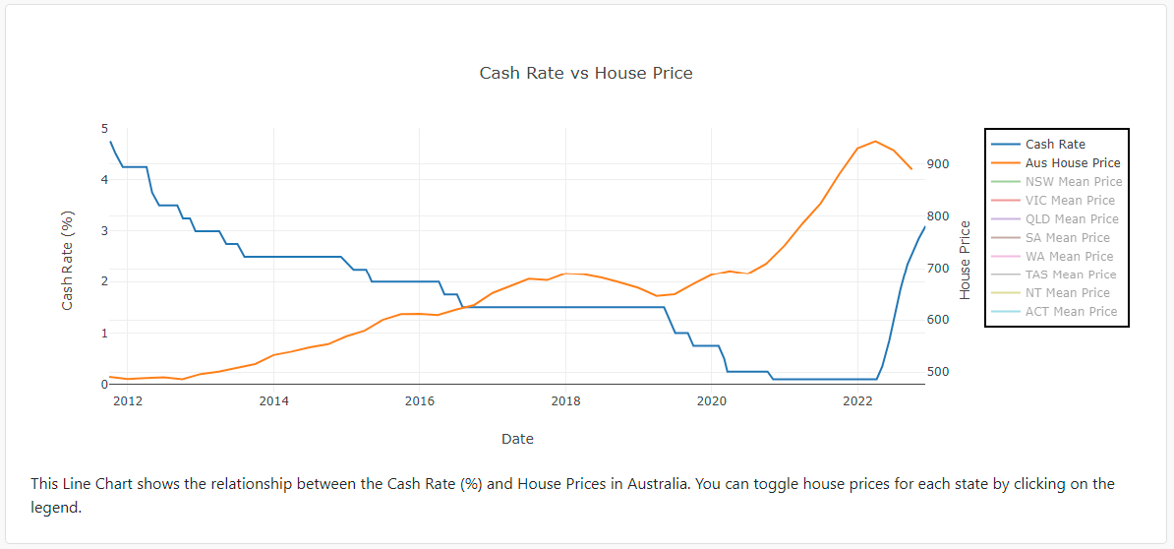
Visualisations
Plotly Line Chart
Notes:
ANSHU
Showcases relationship between interest rate changes and the Australian housing market through average house prices.
The graph shows the inverse relationship between the Cash Rate and average house prices. When the Cash Rate is high, it's more expensive to borrow and may slow down the housing market resulting in lower how prices. If it's low, borrowing is cheaper and the housing market may become more active.
Benefits of Plotly
Interactive and visually appealing representation of data
Allows for easy comparison of different states or Australia as a whole

Slide 10
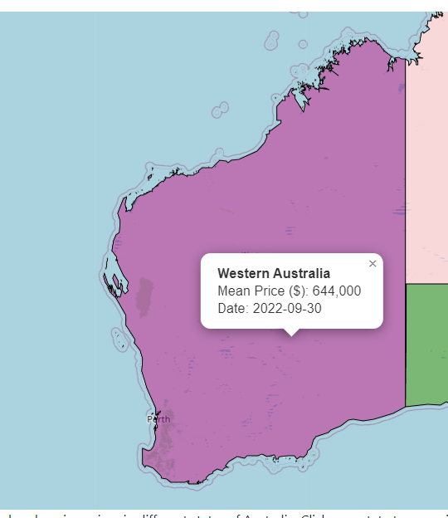
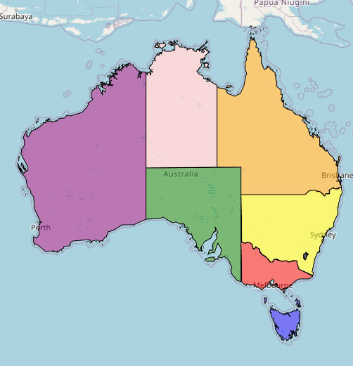
Visualisations
Leaflet Map
Notes:
ZALAK
This interactive map allows users to explore current housing prices in different states of Australia. Created using Leaflet, using D3 to import the GeoJSON for the different states.
Users can click on a state to zoom in and see the latest mean house price in a pop-up and can use the chart to compare house prices among different states.

Slide 11
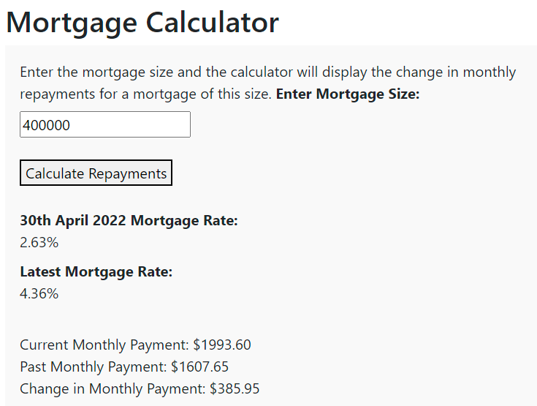
Visualisations
Interactive Mortgage Calculator
Notes:
ZALAK
The mortgage calculator is a tool that allows users to calculate the monthly mortgage payment based on the mortgage size.
The calculator provides a quick and simple way for users to understand the impact of different interest rates on monthly mortgage payments.
The function is built so that it can be reused.

Slide 12
Limitations & Future Work
04

Slide 13
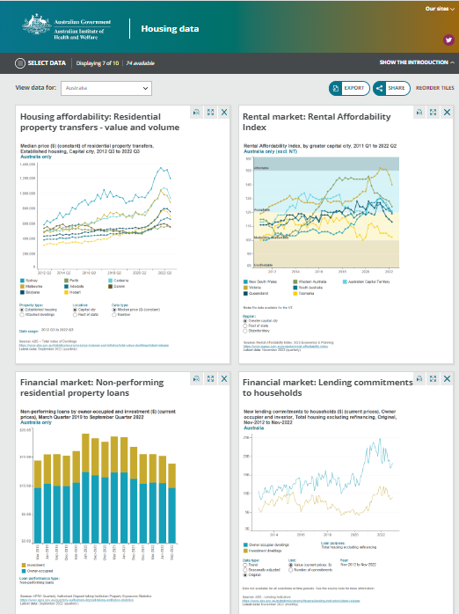
Limitations & Future Work
Data Coverage
Highlight areas for improvement
Potential future developments
New data sources and visualizations
Improved Data Storage
GitHub repository: https://github.com/Frankr22/InteractiveDataViz
Notes:
There’s opportunities for future development and expansion of this project, such as incorporating additional data sources or expanding the scope of the analysis.
For example useful mortgage delinquency data, inflation data, and other key macroeconomic housing market indicators
Improved layout css and html
Time consuming,
More interactivity
Database setup
The current setup uses SQLAlchemy as the Object Relational Mapper (ORM) to interact with a remote database hosted on Amazon Web Services (AWS). The database username and password are stored in a gitignore file (console.py) to protect sensitive information.
A simpler and more straightforward solution, would be to switch the database to a local SQLite database that is stored as a file on the user’s local machine. The SQLite database does not require a remote connection or authentication, so there is no need to store the database credentials in a separate file.
With the current setup, the database is hosted remotely on AWS and requires a connection over the internet, which can be slower and more susceptible to network issues. With the SQLite option, the database is stored locally on the user's machine, which allows for faster access times and eliminates the need for a remote connection.

Slide 14
Q&A
Notes:
That’s the end of our presentation, so now we’ll open up to some questions.

